Slide 1
Regularization techniques in Neural Networks

Slide 2
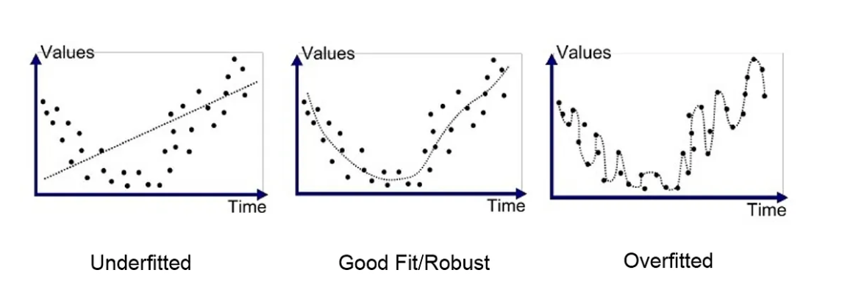
Main idea – To avoiding overfitting

Slide 3
What you already know…
… One way to prevent overfitting is by properly tuning the hyperparameters.

Slide 4
What is a regularization?
Regularization refers to any modification applied to a learning algorithm to minimize its generalization error, without necessarily reducing the training error.
It often involves adding constraints or restrictions to help the model generalize better.

Slide 5
Regularization Techniques We'll Cover Today
Early Stopping
L1/L2 Norm
Dropout

Slide 6
Early Stopping
During neural network training, there comes a point where the model stops learning to generalize and instead focuses on memorizing the noise in the training data.
Solution: Stop training when the generalization error starts to increase.
Note: This is why, in the assignment, you need to search through the hyperparameter space to find the optimal number of epochs. A higher number of epochs doesn’t always mean better performance on the validation/test set!
Important: This technique restricts the training duration.

Slide 7
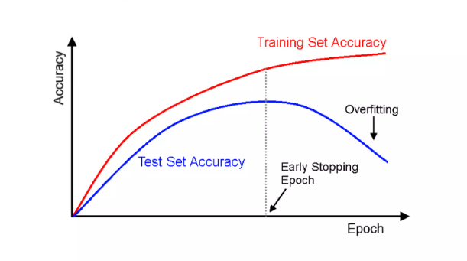
Early Stopping

Slide 8
Be aware!
Keep in mind that early stopping not only prevents overfitting but also conserves resources.
In practice, we define a patience parameter: patience = 10 means training will stop if there’s no improvement in validation loss or accuracy for 10 consecutive epochs.
After stopping, the model's weights are reverted to those from the epoch with the lowest validation loss.

Slide 9
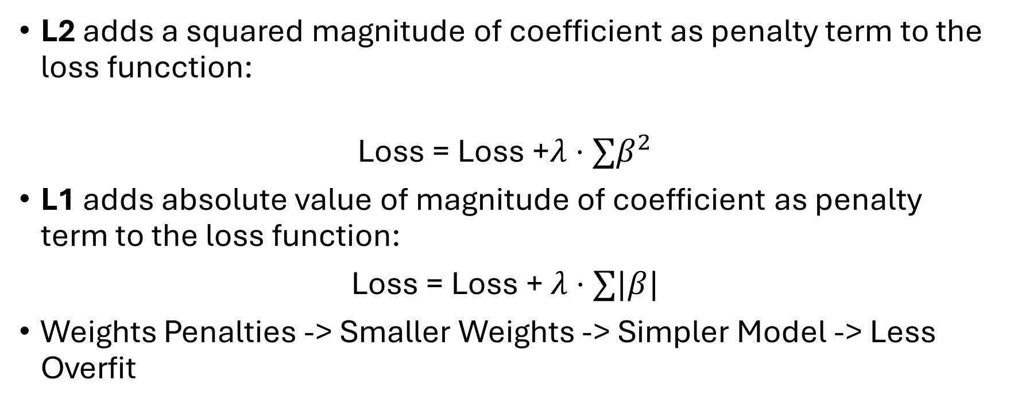
L1/L2 Regularization
L2 adds a squared magnitude of coefficient as penalty term to the loss funcction:
Loss = Loss +$λ⋅∑β^{2}$
L1 adds absolute value of magnitude of coefficient as penalty term to the loss function:
Loss = Loss + $λ⋅∑|β|$
Weights Penalties -> Smaller Weights -> Simpler Model -> Less Overfit

Slide 10
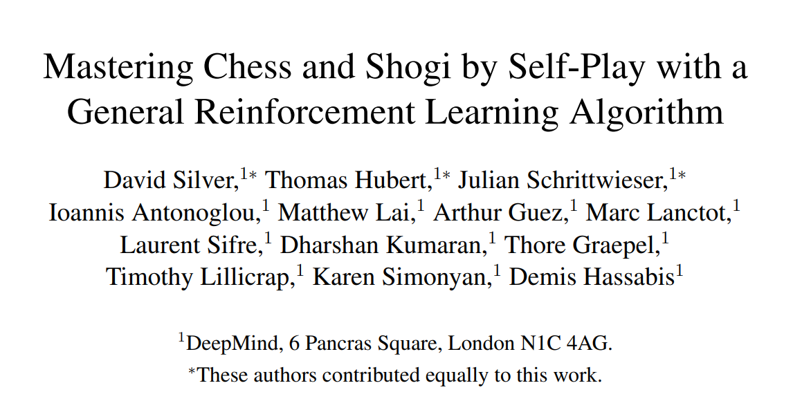
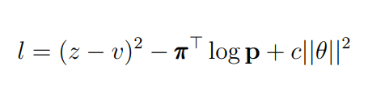
L2 Regularization was for example used in Alpha Zero

Slide 11
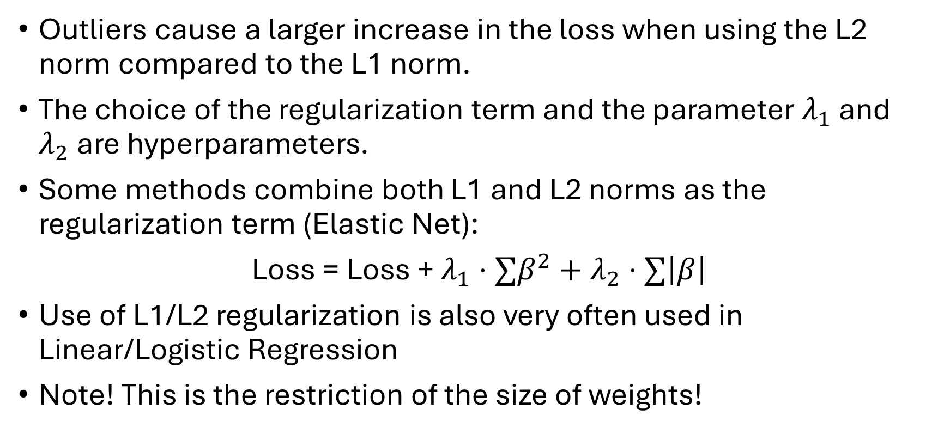
Few words about L1/L2 Regularization
Outliers cause a larger increase in the loss when using the L2 norm compared to the L1 norm.
The choice of the regularization term and the parameter $λ_{1}$ and $λ_{2}$are hyperparameters.
Some methods combine both L1 and L2 norms as the regularization term (Elastic Net):
Loss = Loss + $λ_{1}⋅∑β^{2}+λ_{2}⋅∑\left|β\right|$
Use of L1/L2 regularization is also very often used in Linear/Logistic Regression
Note! This is the restriction of the size of weights!

Slide 12
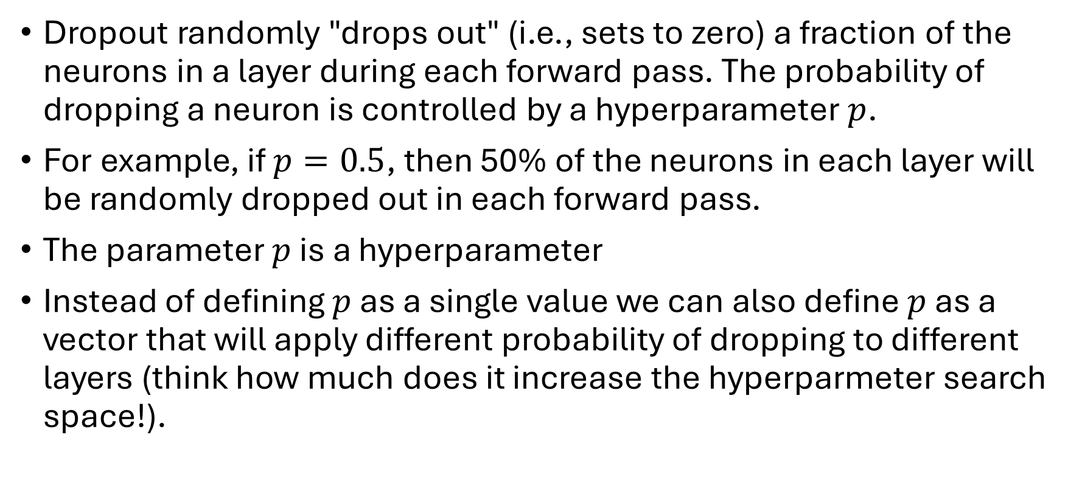
Dropout – training phase
Dropout randomly "drops out" (i.e., sets to zero) a fraction of the neurons in a layer during each forward pass. The probability of dropping a neuron is controlled by a hyperparameter $p$.
For example, if $p=0.5$, then 50% of the neurons in each layer will be randomly dropped out in each forward pass.
The parameter $p$ is a hyperparameter
Instead of defining $p$ as a single value we can also define $p$ as a vector that will apply different probability of dropping to different layers (think how much does it increase the hyperparmeter search space!).

Slide 13
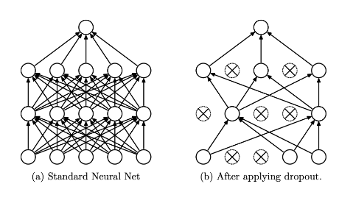
Dropout visualization

Slide 14
Dropout – training phase
By randomly dropping out neurons, dropout prevents the model from relying too heavily on any specific neuron. This forces the model to learn more robust and general features that are not overly dependent on any particular subset of neurons.
During backpropagation, only the weights associated with the active (non-dropped) neurons are updated.

Slide 15
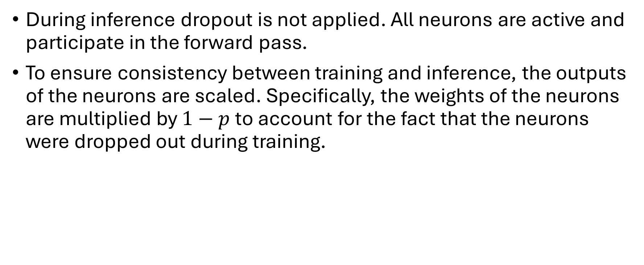
Dropout – test phase
During inference dropout is not applied. All neurons are active and participate in the forward pass.
To ensure consistency between training and inference, the outputs of the neurons are scaled. Specifically, the weights of the neurons are multiplied by $1−p$ to account for the fact that the neurons were dropped out during training.

Slide 16
Dropout
In the paper that introduces Dropout, the authors mention that this technique is comparable to averaging over a large number of individual networks.
It is more or less similar to idea of avoiding overfitting as Random Forest (Bagging)
Note: This acts as a restriction on the architecture!

Slide 17
Thank you for your attention!

